Slide 1
Optimization of Wavelets for Time Series Classification with Support Vector Machine
Team: Karnargus
William Argus & Karndeep Rai-Bhatti

Slide 2
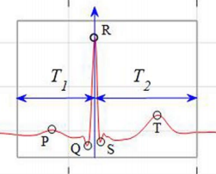
Problem Summary
Given a segment of time series data, quickly and accurately classify the data
Medical Data - ECG
Sensor Data - Gait
Environmental Data - Driving Surface
Classification of time series data
Manual analysis is inefficient, laborious, and error prone
Framed as a Pattern Detection problem
Small training set
Notes:
Karndeep
The goal of out work …
A key example is medical data ecg - patients heart monitor
Train on 5 minutes of data and robustly and accuratly predict from that point forward
This solves a problem where analysis is typically …
Frame our problem ...
Want to develop this classification technique in the context of the ECG problem and apply it the parallel problems in other disciplines
Hint at gait and data

Slide 3
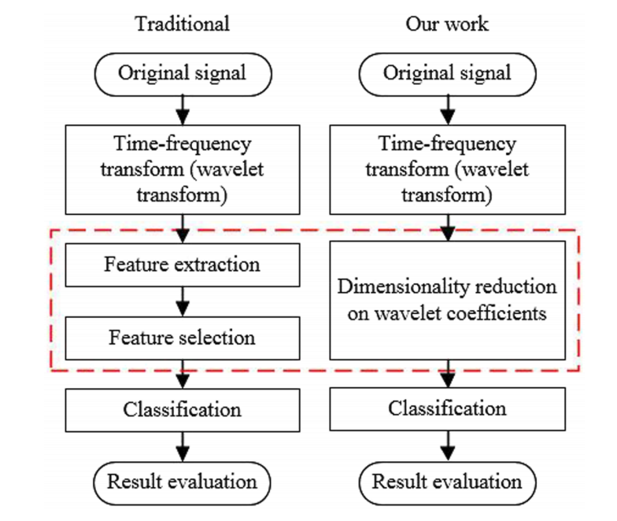
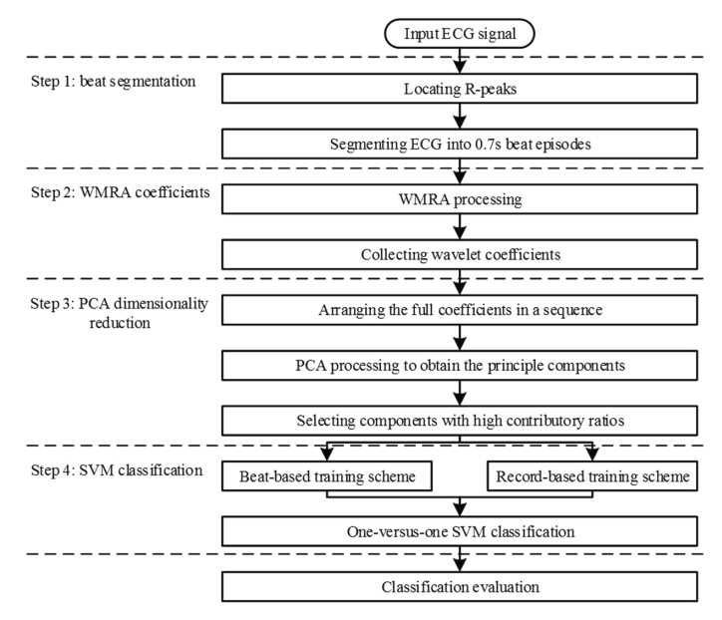
Other Approaches: Pro and Con
Acharya et al.
Bior Wavelet Transform > sub-band fuzzy entropy & log-energy > Binary SVM classification
Min et al.
PCA, LDA, ICA > classification with NN, SVM classifiers, PNN
Liu et al.
bior(6,8) Wavelet Transform > PCA > SVM
Melgani et al.
Wavelet optimization: wavelet > SVM
Pro: Consistently Get high accuracy ~ 99%
Common Problem: Classification schemes optimized/trained across whole database
Underperform in realistic setting where only prior data is available
Notes:
Will
With that in mind, there are 2 notable approaches to this problem using wavelets

Slide 4

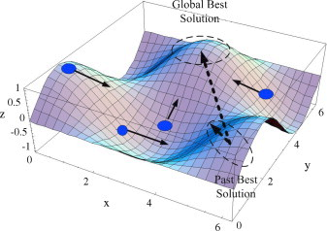
Proposed Approach
Initialize θ & velocity values for each particle
Baseline - Classification Scheme Proposed by Liu et al.
Beat Segmentation
8-level WMRA using bior(6,8) wavelets
12 component PCA transform for SVM transform
Optimize Wavelet using Particle Swarm Optimization (PSO)
Search over Orthonormal Wavelets
Construct Wavelet (Sherlock-Monro algorithm)
Update θs & velocity based on
local and global min error
8-level WMRA
PCA: Dimension reduction
An Example of particles motion across the space defined by particle’s location and the current error
Train SVM, Calculate Error
Notes:
Karndeep
Our plan
build upon the work of Liu et al.
By optimizing a new wavelet using PSO
Few key point
Orthonormal wavelets because they are easily parameterizable
Compacy representation
Optimizing over a smaller vector space, and bound by 0 and 2pi
Pulling the theta values from a uniform distribution

Slide 5
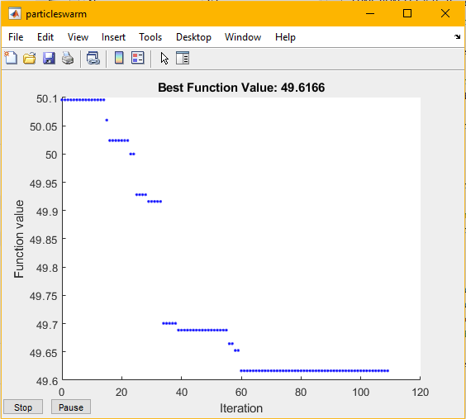
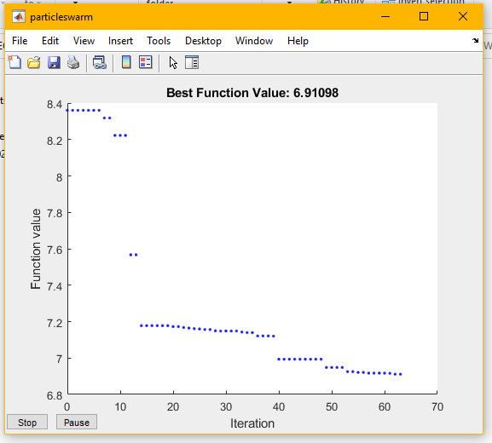
Results of Particle Swarm Optimization
Record Based Training
PSO used to find 2 different wavelets
SVM is trained under record based scheme (independent patients train vs test)
SVM is trained under beat based scheme (same patient)
40 particles
Trained on 500 samples, tested on 10,000
Beat Based Training
Notes:
william
No cross validation and only trained on 500 samples due to computational constraints

Slide 6
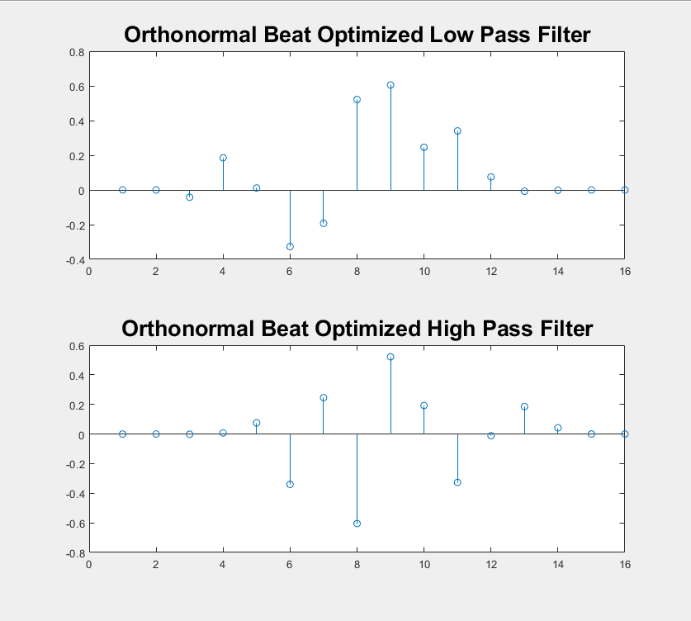
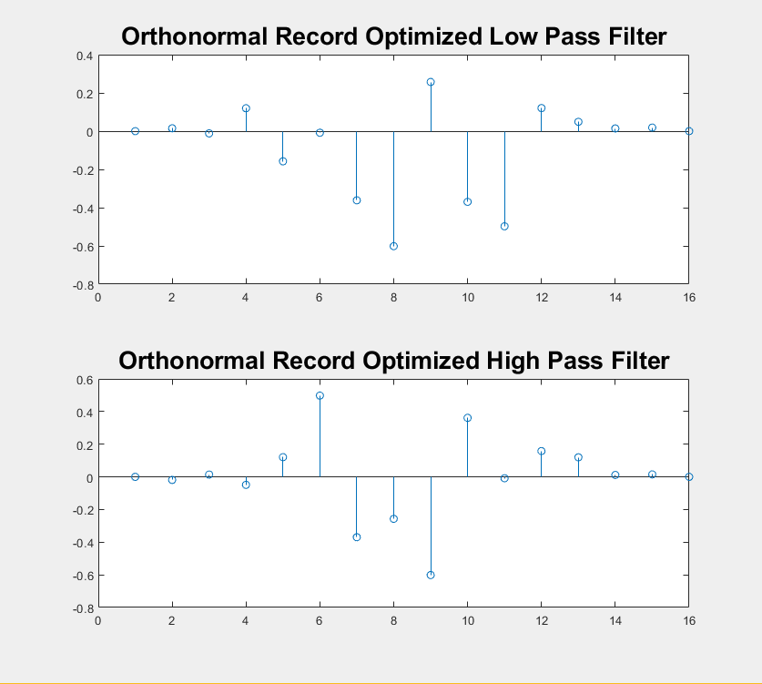
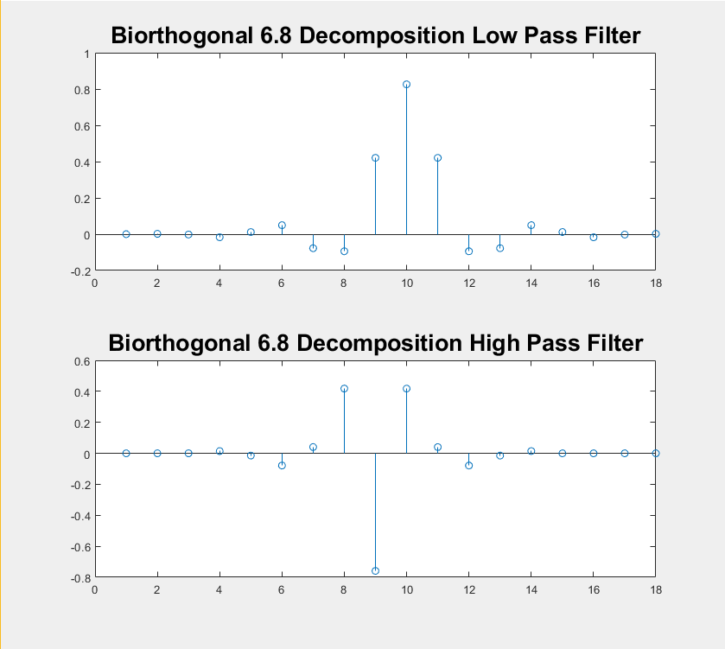
Optimized Wavelets and Bior(6,8) Structures
The structure of the final beat optimized and record optimized wavelet compared to Bior(6,8)
Resulting wavelets shown are after convergence of PSO
Notes:
William

Slide 7
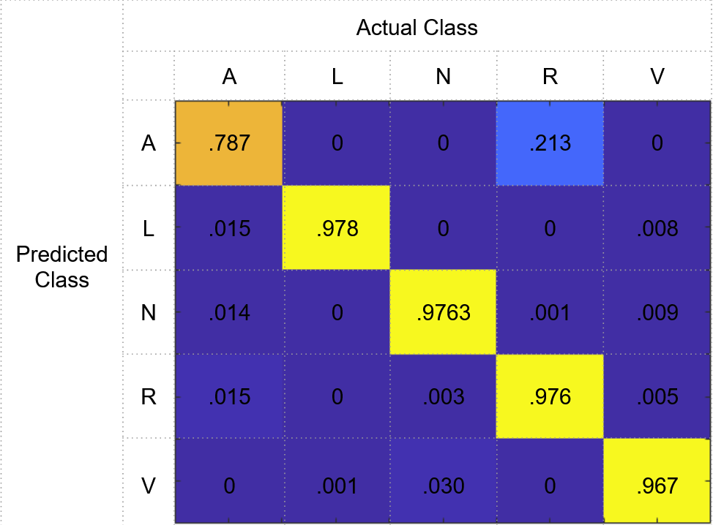
Optimized Wavelets Applied to the Stated Problem
Train/Test split | Bior(6,8) | Record based Optimization | Beat based Optimization
Random 20/80 | 96.2% | 98.79% | 98.46%
300 beats/ remainder | 97.30% (4%) | 97.54% (3.85%) | 97.80% (3.69%)
60 beats/ remainder | 94.35% (7.97%) | 94.58% (7.86%) | 94.05% (9.04%)
Example Confusion Matrix, from Record based optimized wavelet, 300 beats
Tested using 10 fold cross validation
Notes:
KArndeep
With those wavelets generated we wanted to Compare them with state-of-the-art Bior(6,8)
Increasing difficulty
Began with the unrealistic case
Consistently showed a minor improvement in most tasks
, right bundle branch block classified as , atrial premature contraction

Slide 8
Summary
Problem to be solved
Design an approach to classify ECG signals
Show it performs well in realistic scenarios
Proposed approach
Use wavelet decomposition and PCA, classify with SVM
Optimized out own Wavelet using Particle Swarm Optimization
Results
2 Optimized Wavelets compared favorably with Bior(6,8)
Conclusion
Optimized wavelets performed comparably to Bior(6,8)
Improvement may be possible with more computational resources

Slide 9
Works Cited
[1] Acharyabcd, U.Rajendra. “A New Method to Identify Coronary Artery Disease with ECG Signals and Time-Frequency Concentrated Antisymmetric Biorthogonal Wavelet Filter Bank.” Pattern Recognition Letters, vol. 125, 1 July 2019, pp. 235–240.
[2] Daamouche, Abdelhamid & Hamami, Latifa & Alajlan, Naif & Melgani, Farid. (2012). A wavelet optimization approach for ECG signal classification. Biomedical Signal Processing and Control - BIOMED SIGNAL PROCESS CONTROL. 7. 10.1016/j.bspc.2011.07.001.
[3] Fatin, A. E. et al. Arrhythmia recognition and classification using combined linear and nonlinear features of ECG signals. Comput. Methods Programs Biomed. 127, 52–63 (2016).
[4] Martis, R. J., Acharya, U. R. & Min, L. C. ECG beat classification using PCA, LDA, ICA and discrete wavelet transform. Biomedical Signal Processing and Control 8, 437–448 (2013).
[5] Martis, R. J. et al. Characterization of ECG beats from cardiac arrhythmia using discrete cosine transform in PCA framework. Knowledge-based Systems 45, 76–82 (2013).
[6] Qin, Q., Li, J., Zhang, L. et al. Combining Low-dimensional Wavelet Features and Support Vector Machine for Arrhythmia Beat Classification. Sci Rep 7, 6067 (2017). https://doi.org/10.1038/s41598-017-06596-z
[7] Sherlock, B., & Kakad, Y.P. (2002). MATLAB Programs for Generating Orthonormal Wavelets.

Slide 10
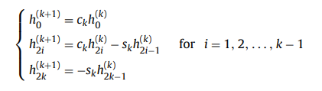
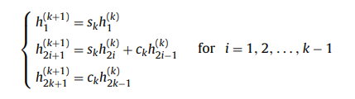
Appendix
Sherlock and Monro recursive formula for orthonormal wavelets

Slide 14
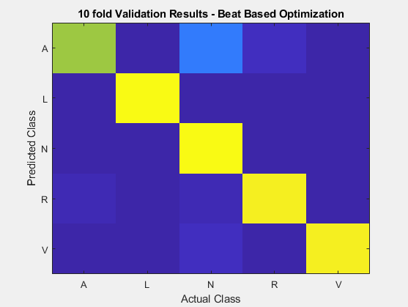
0.702 | 0.002 | 0.260 | 0.036 | 0.001
0.000 | 0.985 | 0.008 | 0.000 | 0.006
0.000 | 0.000 | 0.998 | 0.000 | 0.001
0.026 | 0.000 | 0.020 | 0.952 | 0.002
0.001 | 0.002 | 0.037 | 0.001 | 0.960

Slide 15
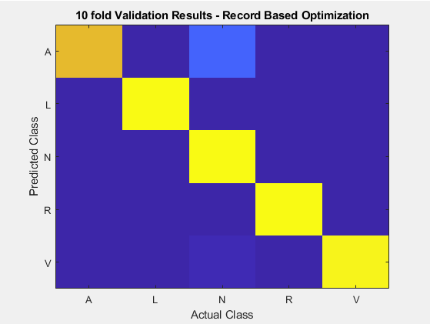
0.790 | 0.002 | 0.187 | 0.014 | 0.007
0.000 | 0.985 | 0.007 | 0.000 | 0.008
0.001 | 0.000 | 0.996 | 0.000 | 0.003
0.002 | 0.000 | 0.009 | 0.984 | 0.005
0.000 | 0.002 | 0.027 | 0.000 | 0.9702

Slide 16
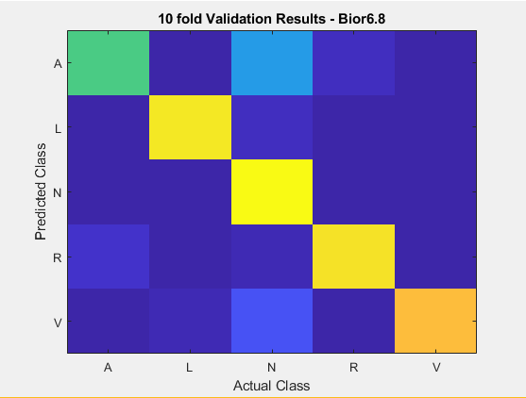
0.601 | 0.013 | 0.346 | 0.038 | 0.002
0.006 | 0.944 | 0.043 | 0.001 | 0.006
0.001 | 0.003 | 0.993 | 0.001 | 0.003
0.051 | 0.001 | 0.029 | 0.918 | 0.001
0.004 | 0.019 | 0.1441 | 0.001 | 0.835

Slide 17
Other Approaches: Pro and Con
Acharya et al.
Wavelet Transform > sub-band fuzzy entropy & log-energy > Binary SVM classification
Min et al.
PCA, LDA, ICA > classification with NN, SVM classifiers, PNN
Melgani et al.
Wavelet optimization: wavelet > SVM
Pro: Consistently Get high accuracy ~ 99%
Common Problem: Classification schemes optimized/trained across whole database
Underperform in realistic setting where only prior data is available
Notes:
With that in mind, there are 2 notable approaches to this problem using wavelets

Slide 18
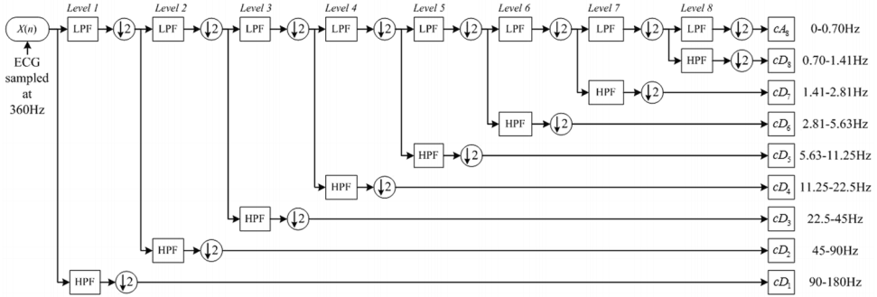
Proposed Approach
Classification Scheme Proposed by Liu et al.
8 level WMRA using bior(6,8) wavelets as baseline
PCA
Optimize Wavelet with Particle Swarm
Compare optimized wavelet to bior(6,8)
Train on initial samples and try to predict the rest
Notes:
Given an ECG signal, they individually segment each beat
Sent to 8 level FB
10 fold cross validation

Slide 19
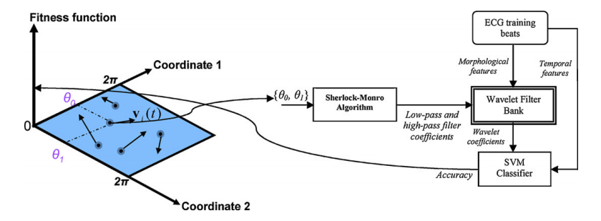
Particle Swarm Optimization of a Wavelet
Initialize theta values for each particle
Wavelet is defined by values of theta
Each particle represents the theta values defining a possible wavelet
Particle’s velocity is influenced by the best local and global position
The best positions are determined by the classification error found using the process on the right
Exact particle trajectory equations are in the appendix
Recursively construct mother wavelet with theta parameters
Using error and particle velocity, update theta values
WMRA
PCA: Dimension reduction
An Example of particles motion across the space defined by particle’s location and the current error
Train SVM, Calculate Error

Slide 20
Proposed Approach
Initialize theta values for each particle
Optimize Wavelet for EKG signal Classification
Compare to Liu et al, which used bior(6,8) wavelets
Particle Swarm Optimization
Particles are defined by theta values representing a possible wavelet
Velocity influenced by the best local and global positions
Exact particle trajectory equations in the appendix
The best positions are determined by the classification error found using the process on the right
Recursively construct mother wavelet with theta parameters
Using error and particle velocity, update theta values
WMRA
PCA: Dimension reduction
An Example of particles motion across the space defined by particle’s location and the current error
Train SVM, Calculate Error

Slide 21
Proposed Approach
Initialize θ values for each particle
Baseline - Classification Scheme Proposed by Liu et al.
Beat Segmentation
8-level WMRA using bior(6,8) wavelets
PCA
Optimize Wavelet for ECG classification using Particle Swarm Optimization
Search over Orthonormal Wavelets
Construct Wavelet (Sherlock-Monro algorithm)
Update θs and velocity based on
local and global min error
WMRA
PCA: Dimension reduction
Train SVM, Calculate Error
An Example of particles motion across the space defined by particle’s location and the current error
Notes:
Orthonormal wavelets because they are easily parameterizable
Pulling the theta values from a uniform distribution

Slide 22
Results and Comparison 1
Performance - Random Train/Test split
Bior 6,8 - 96.21%
Optimized record based - 98.79%
Optimization Beat based - 98.46%

Slide 24
Results and Comparison 2
First 5 minutes train 300 samples (bpm ~60hz)
Rest as test Average score
Bior6,8 = 97.30% 4% std
Record based = 97.54% 3.85% std
Beat Based = 97.80% 3.69% std
1 minute 60 samples
Bior6,8 = 94.35% 7.97% std
Record based = 94.58% 7.86% std
Beat Based = 94.05% 9.04% std

Slide 25
Sherlock and Monro recursive formula for orthonormal wavelets

Slide 26
Optimized Wavelets Applied to the Stated Problem
Train/Test split | Bior(6,8) | Record based Optimization | Beat based Optimization
Random 80/20 Split | 96.2% | 98.79% | 98.46%
Train on 300, Test on remaining | 97.30% (4%) | 97.54% (3.85%) | 97.80% (3.69%)
1 min/60 beats | 94.35% (7.97%) | 94.58% (7.86%) | 94.05% (9.04%)

Slide 27
Results of Particle Swarm Optimization
Error value is monotone decreasing with each iteration
PSO used to find 2 different wavelets
SVM is trained under record based scheme (independent patients train vs test)
SVM is trained under beat based scheme (same patient)
Decreasing Error under record based training scheme
Evolution of a single Particle and its corresponding Theta Values
One of 40 particles in the swarm
Decreasing Error under beat based training scheme

Slide 28
Initialize θ & velocity values for each particle
Construct Wavelet (Sherlock-Monro algorithm)
Update θs & velocity based on
Local/global min error
8-level WMRA
PCA:
Dimension reduction
Train SVM,
Calculate Error

